Slide 1
QUIQ POS - UX Design Document
Please refer the Page titles.
Enter comments in the pages and revert.

Slide 2
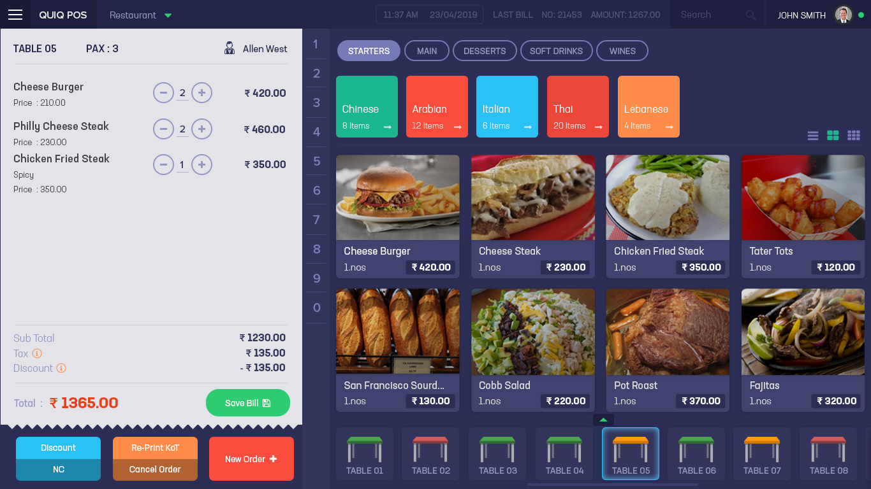
Home Page
Comments

Slide 3
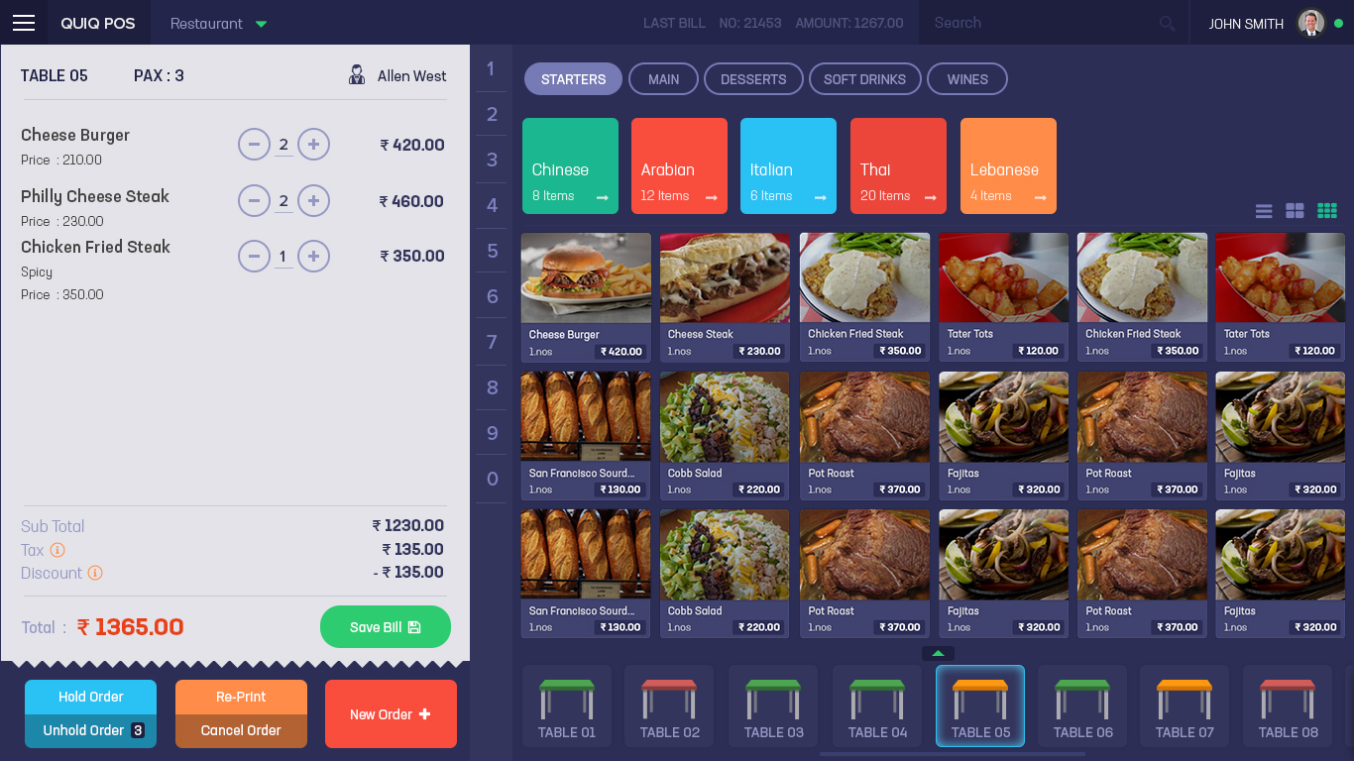
Home Page - Small Thumbnail View
Comments

Slide 4
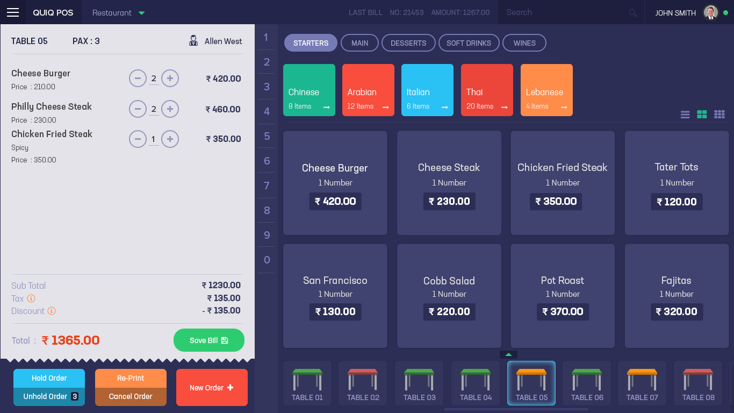
Home Page - No Image
Comments

Slide 5
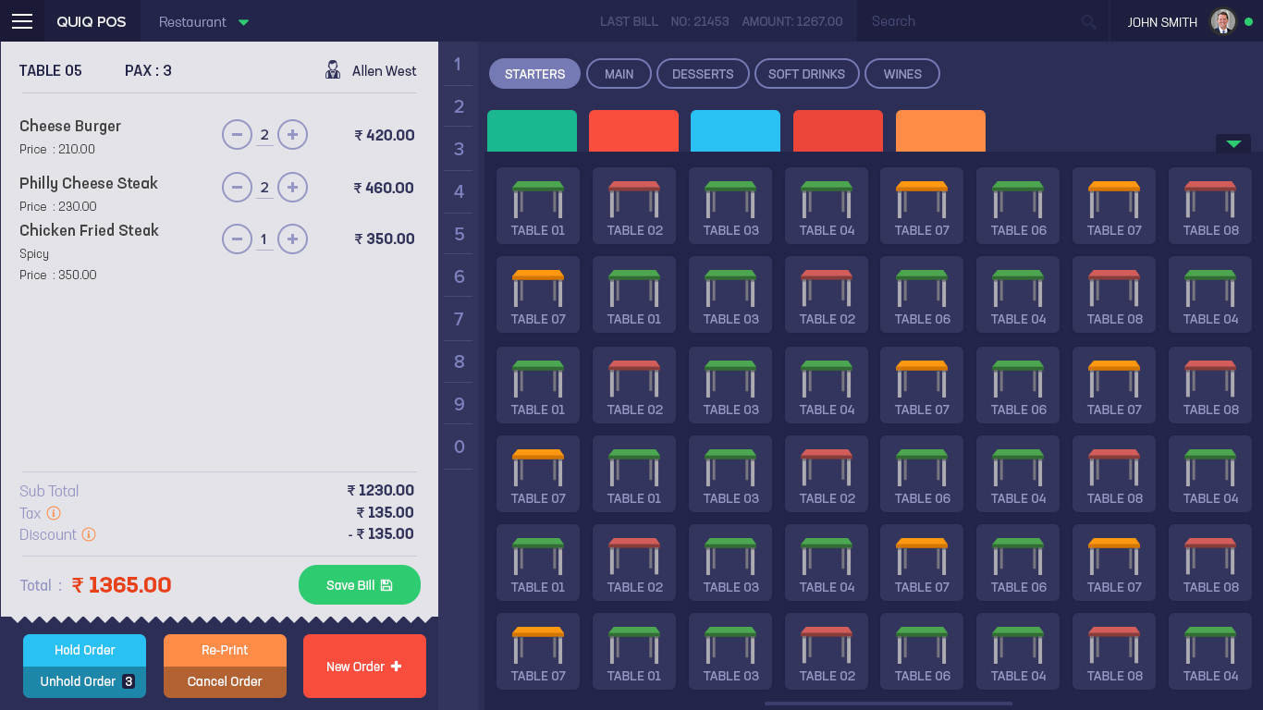
Home Page - Table List Expanded
Comments

Slide 6
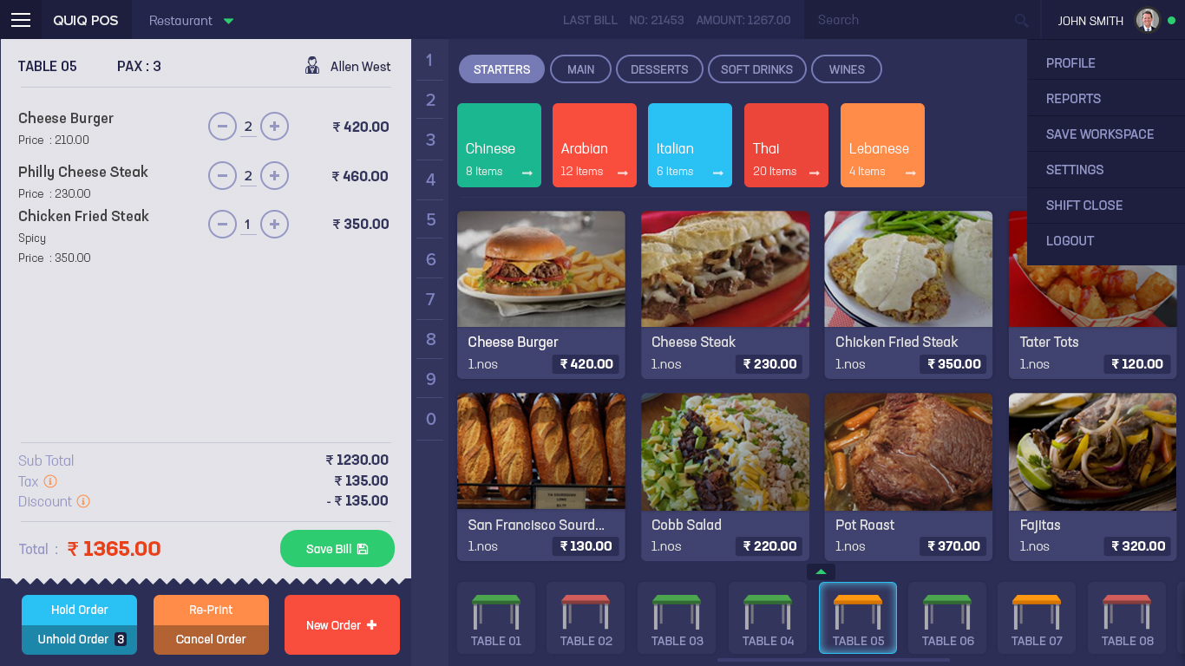
Home Page - User Settings Menu
Comments

Slide 7
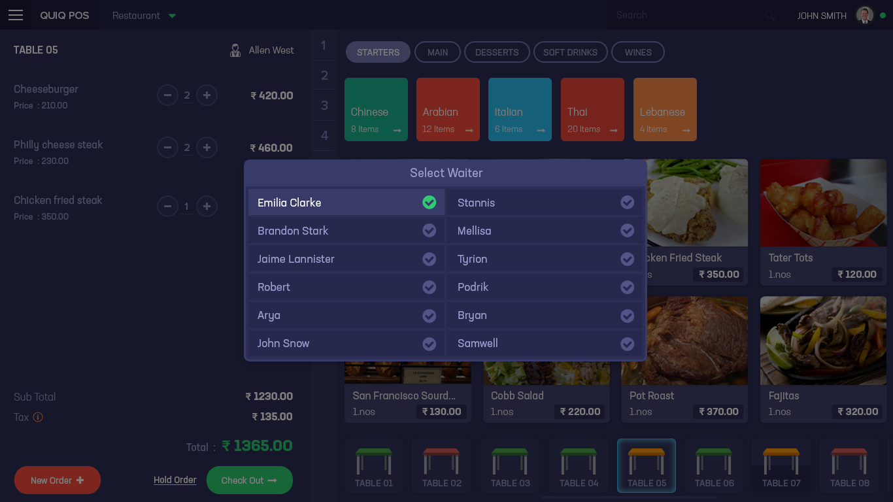
Home Page - Waiter Selection
Comments

Slide 8
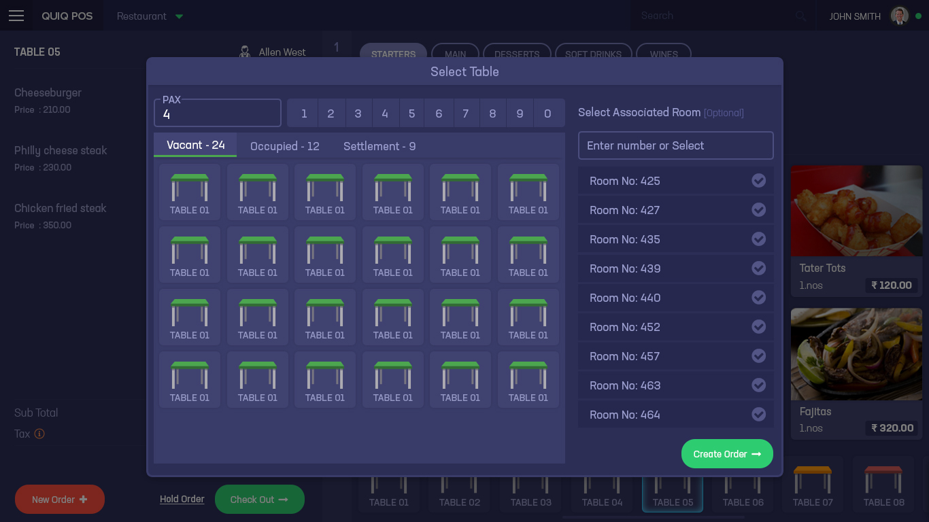
Home Page - Table Selection
Comments

Slide 9
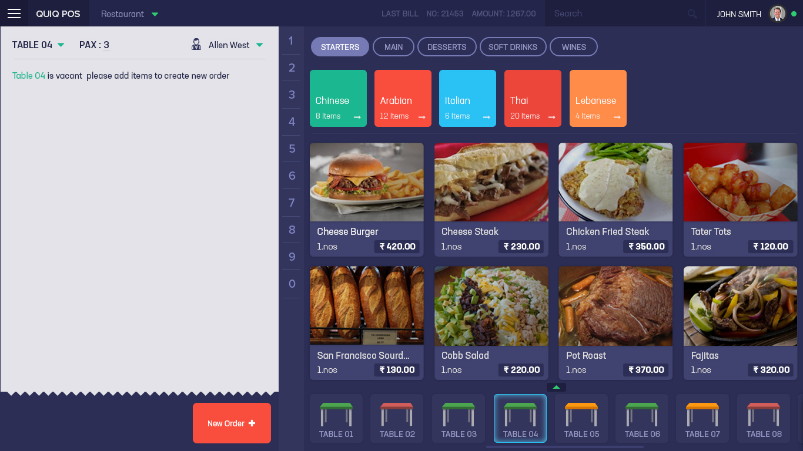
Home Page - New Order from Vacant Table
Comments

Slide 10

Home Page Additional Item button in Bill Preview + Edit PAX
Comments

Slide 11
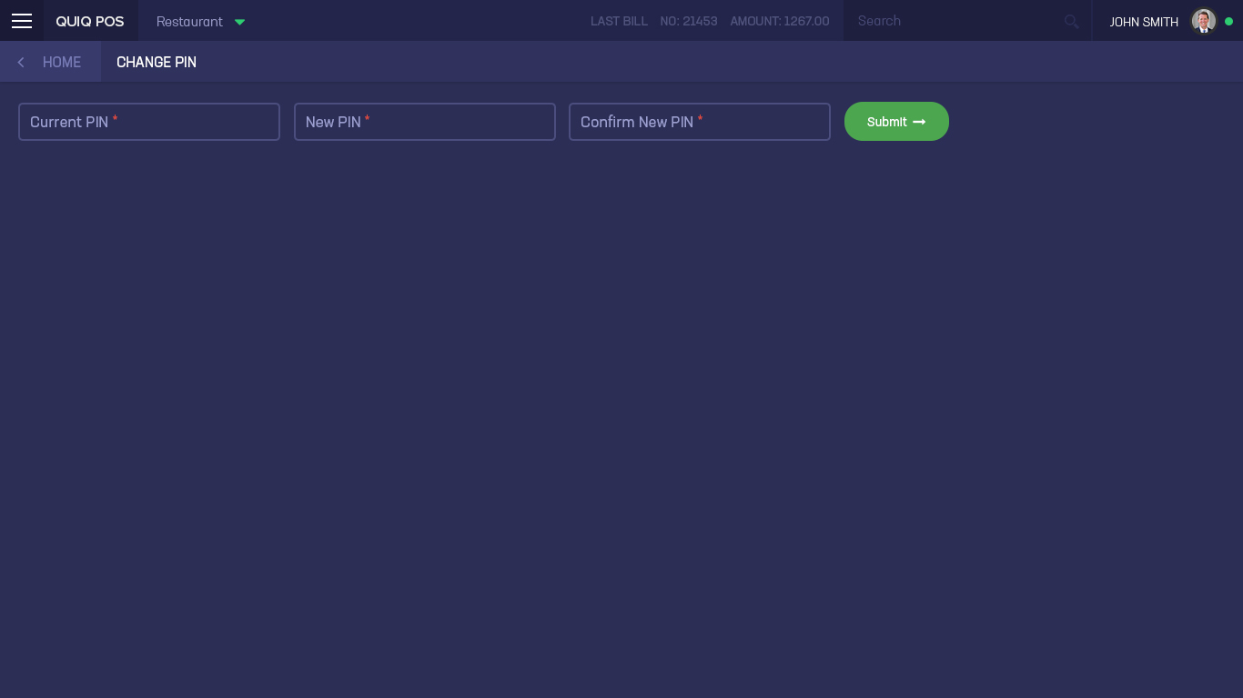
Change Pin
Comments

Slide 12
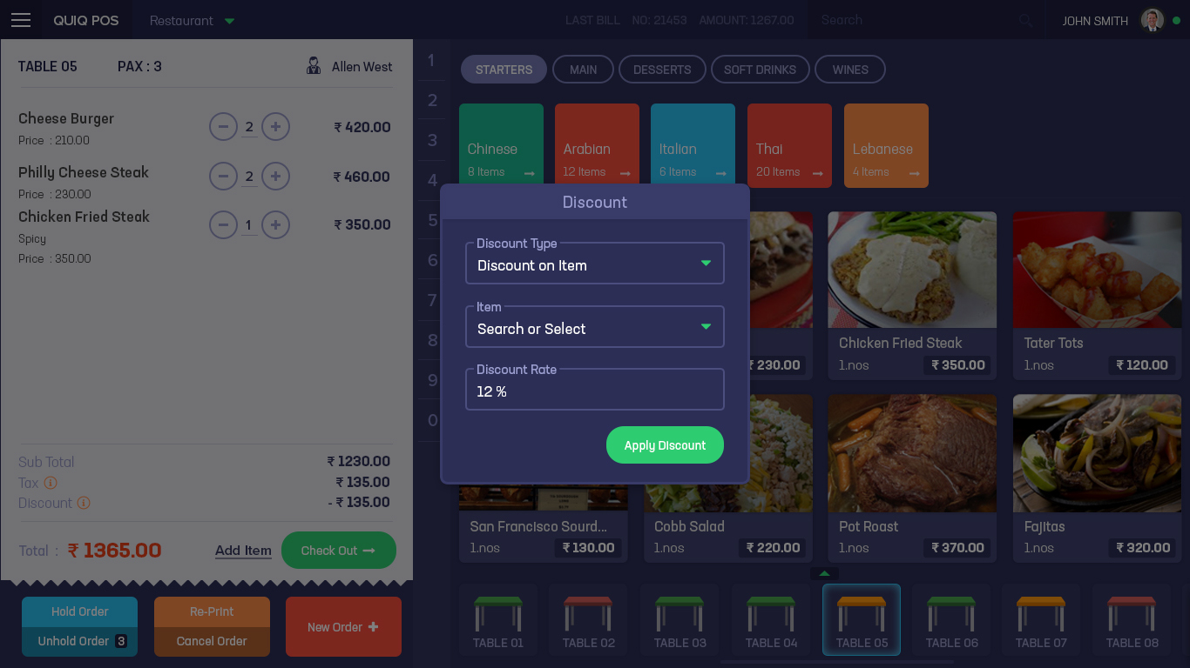
Add Discount
Comments

Slide 13
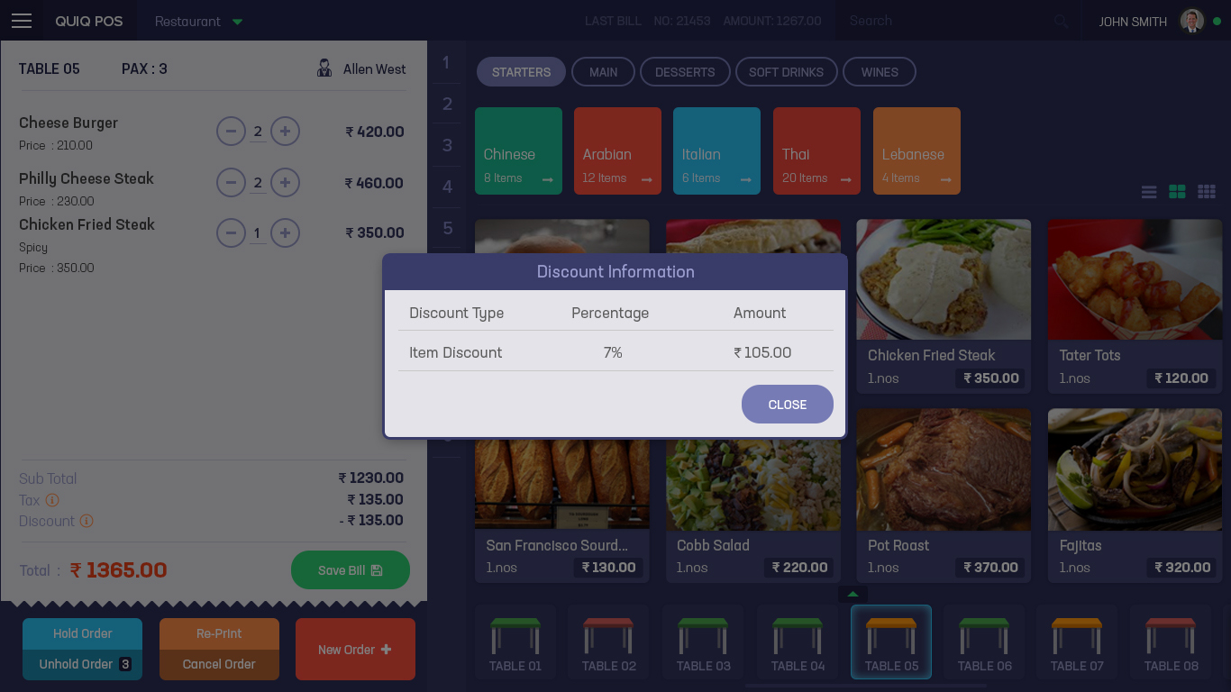
Discount Info
Comments

Slide 14
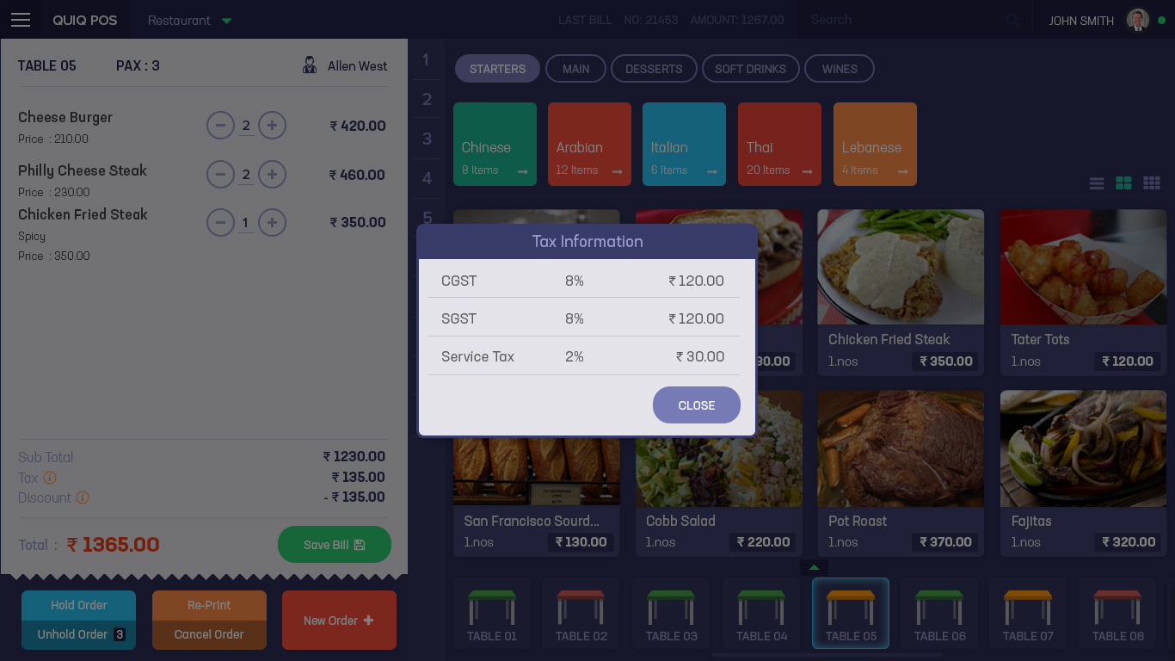
Tax Info
Comments

Slide 15
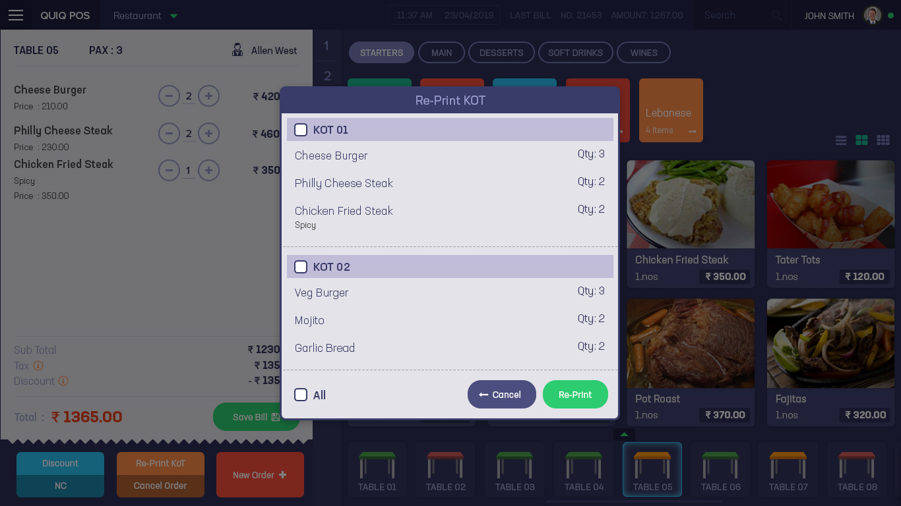
Home Page - Re-Print Kot
Comments

Slide 16
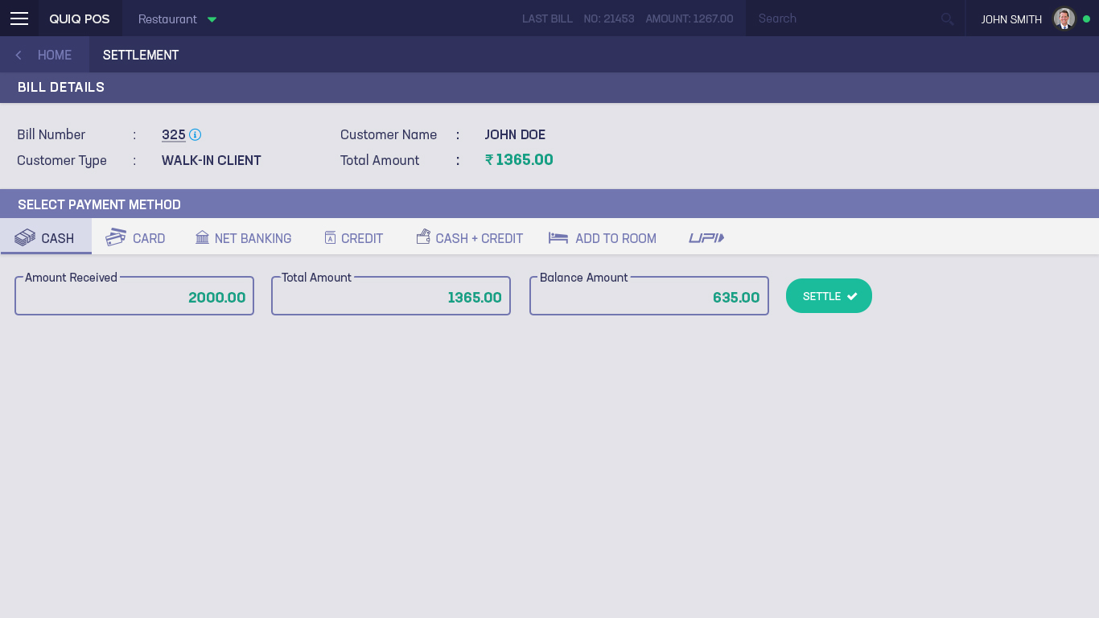
Settlement - Cash
Comments

Slide 17
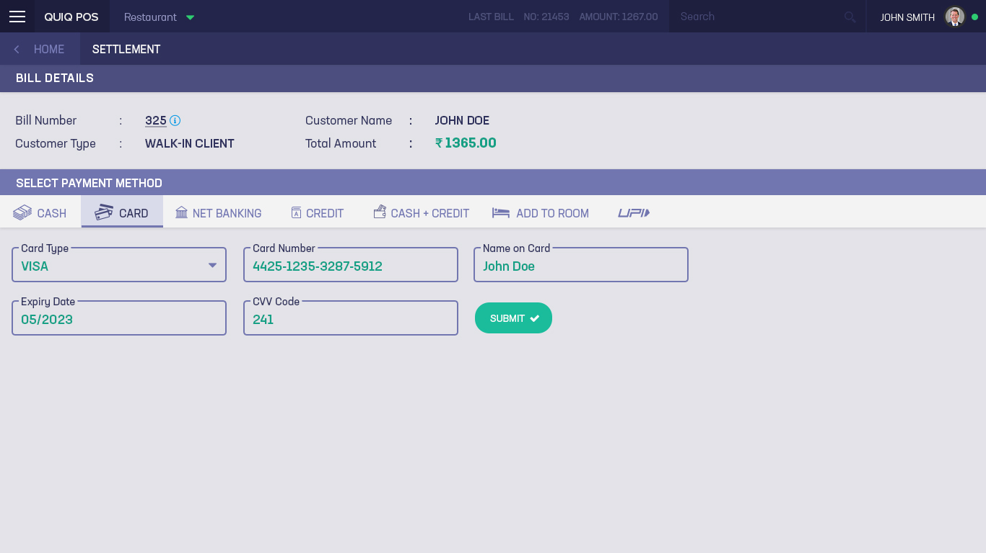
Settlement - Card
Comments

Slide 18
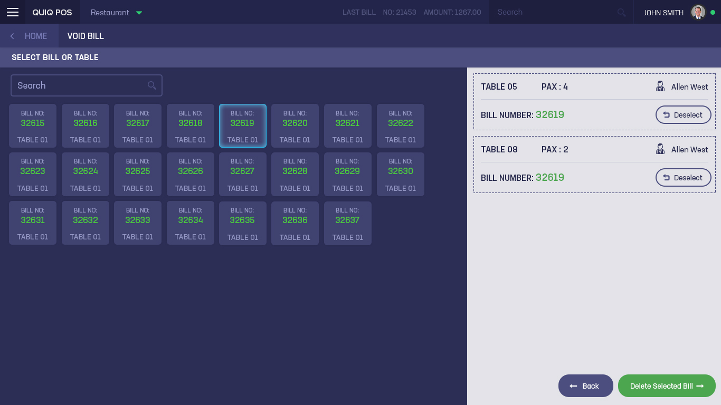
VOID Bill
Comments

Slide 19
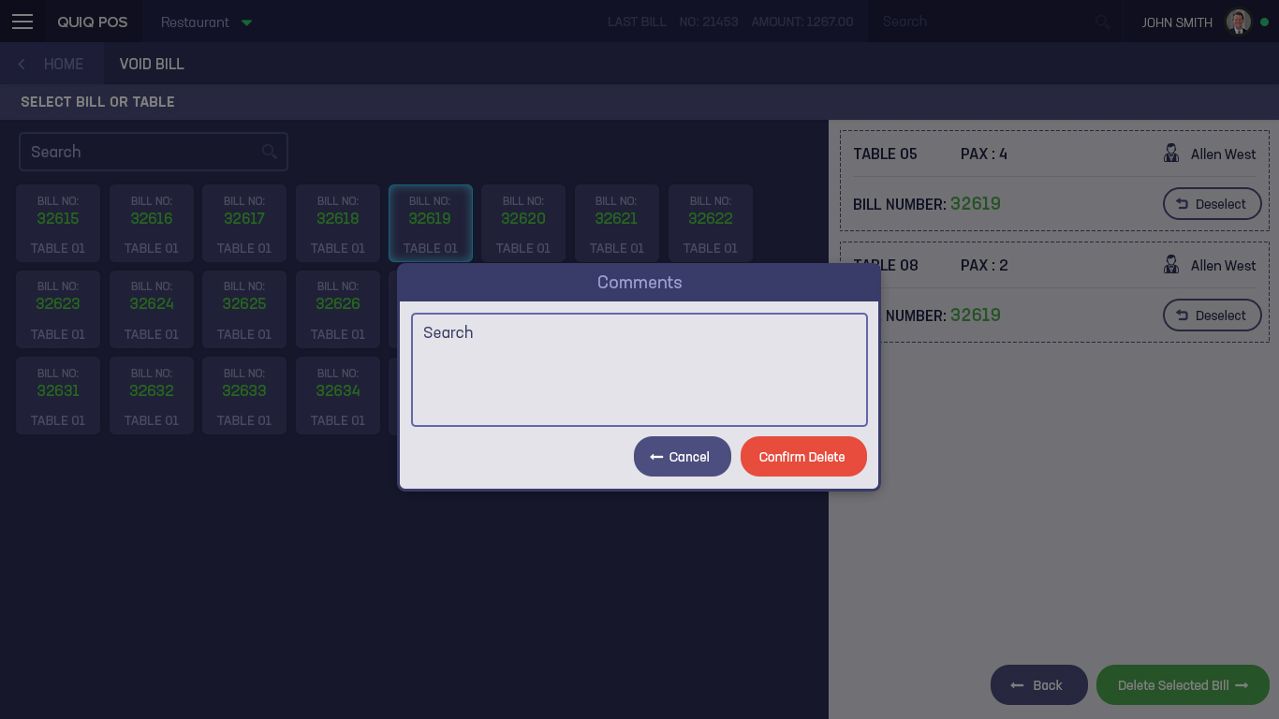
Void Bill Comments and Confirmation
Comments

Slide 20
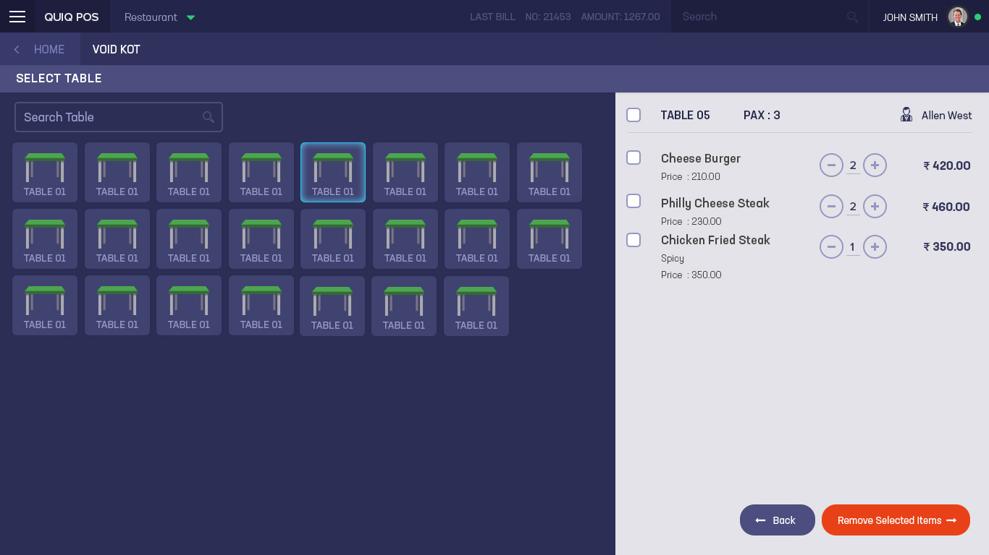
Void KOT
Comments

Slide 21

VOID Bill - Confirmation
Comments

Slide 22
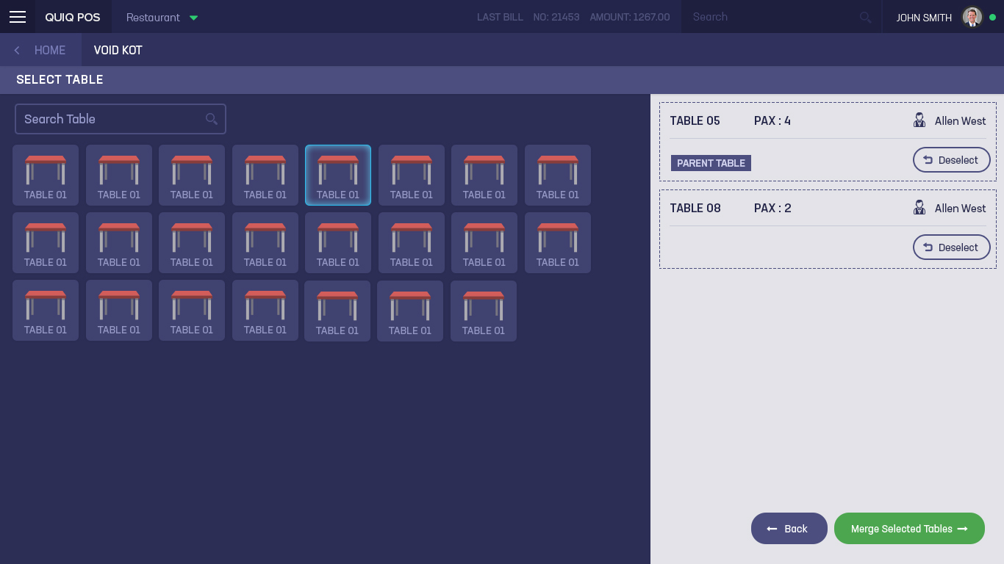
Merge Table
Comments

